Slide 1


REPUBLIC OF TURKEY
THE MINISTRY OF FORESTRY AND WATER AFFAIRS
TURKISH STATE METEOROLOGICAL SERVICE
METEOROLOGICAL SERVICES
IN TURKEY
Ali KARATAŞ Adem YALÇIN
Deputy Director General Regional Office Manager
Banja Luka, BOSNIA AND HERZEGOVINA
28 April 2014

Slide 2
TURKISH STATE METEOROLOGICAL SERVICE
TSMS;
established on 19 February 1937
only authorized governmental agency to carry out meteorological related works and services

Slide 3
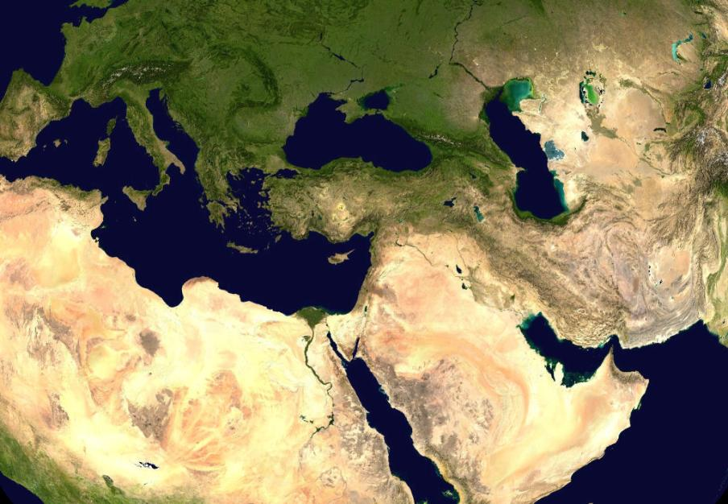
TURKEY
Unique position between the continents
Surrounded by the seas
Open to different air masses
Occurrence of several meteorological phenemona even on same day

Slide 4
OBSERVATION NETWORK
1021 AWOS
62 Airport AWOS
70 Marine AWOS
1153 AWOS
10 C-Band Radar
1 X-Band Radar
2 Marine Radar
8
Upper Air Station
1174 Observation Systems

Slide 5
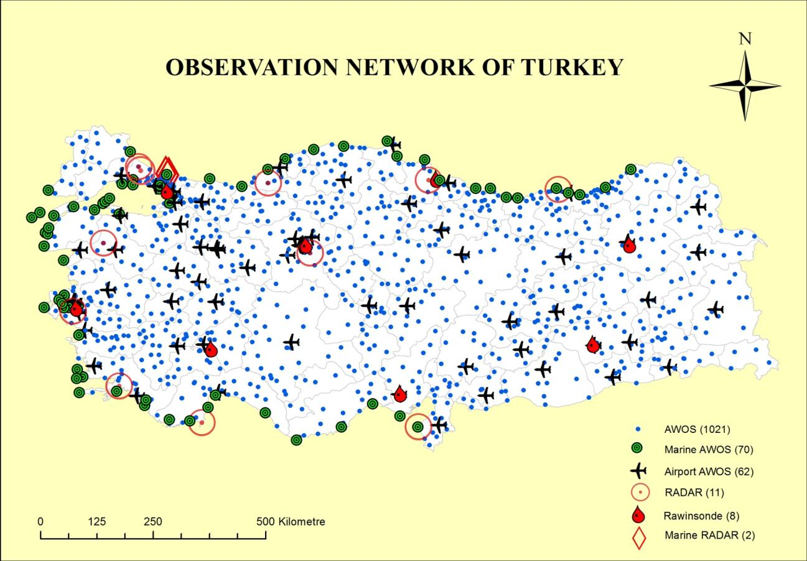
OBSERVATION NETWORK

Slide 6

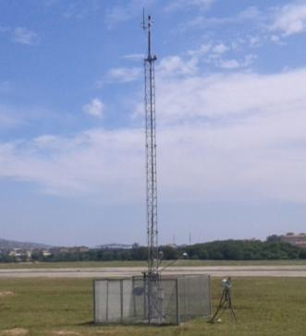
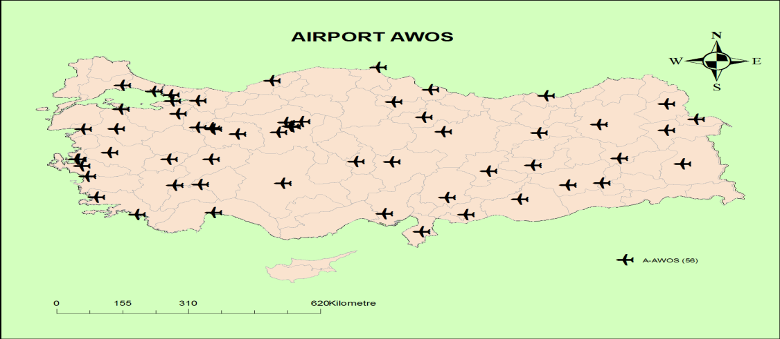

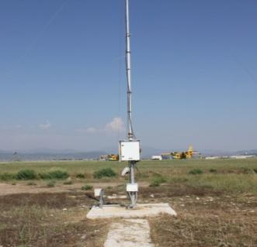
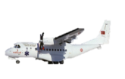
AIRPORT SYSTEMS
24 hours meteorological service at 68 airports
AWOS with latest technology for meteorological observations at 62 airports in accordance with the category of the airport

Slide 7

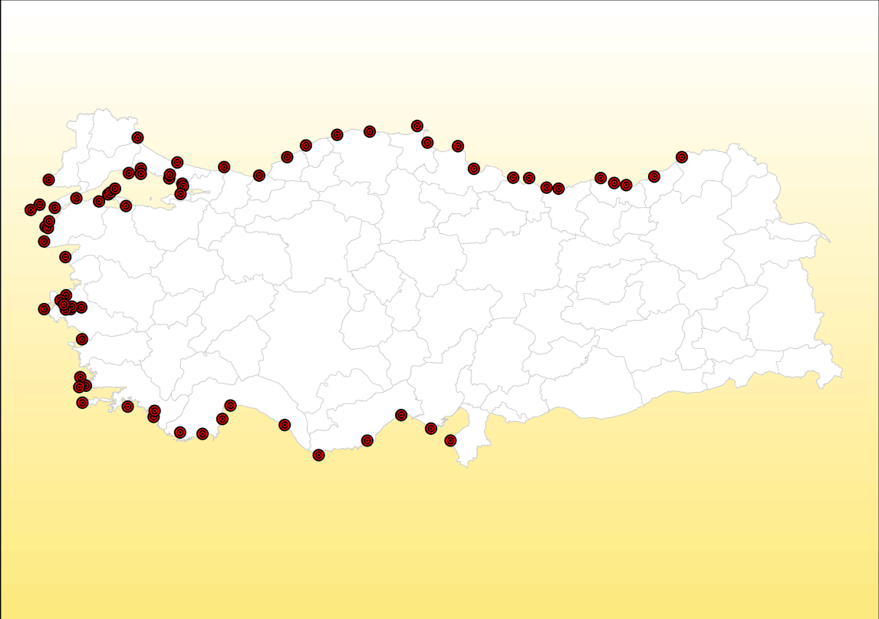
MARINE OBSERVATION NETWORK
MARINE AWOS

Slide 8
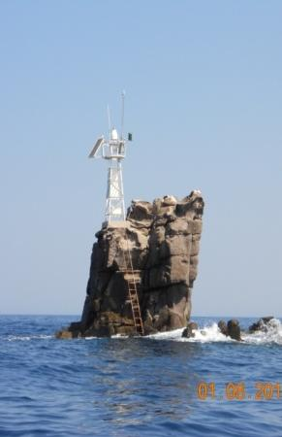
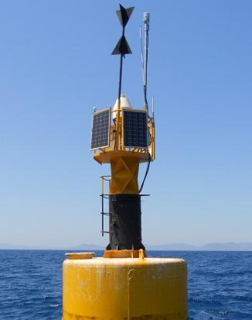
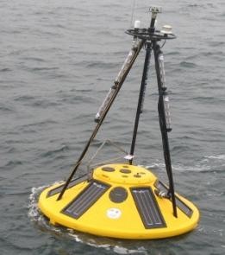
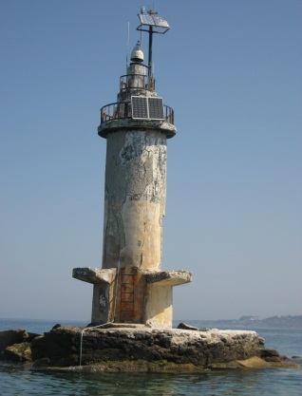
MARINE OBSERVATION NETWORK
70 Marine Automatic Weather Observing Station
9 buoys
Wind speed
Wind direction
Air temperature
Sea water temperature
Air pressure
Precipitation
Wave height
Wave period
Wave direction

Slide 9


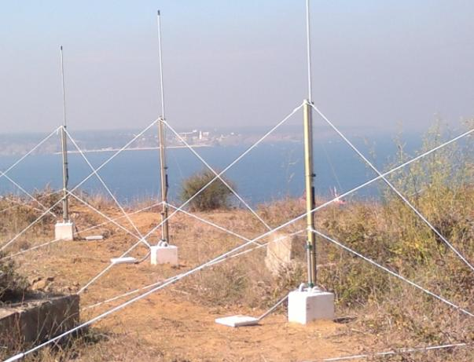
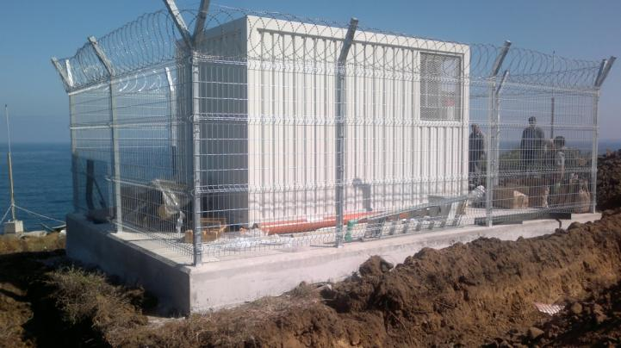
MARINE OBSERVATION NETWORK
HIGH FREQUENCY MARINE RADAR
Wave Height; Wave Spectrum
Wind Direction; Wind Speed
Current Direction; Current Speed

Slide 10
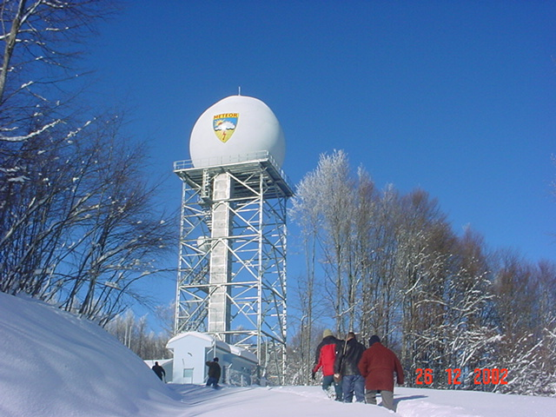
WEATHER RADAR NETWORK
C-Band Doppler Radars
150-200 km observing range
Klystron transmitter; Digital receiver
Narrow beam width (less than 1 degree)
Composite product generation
5 radars with dual polarization capability

Slide 11
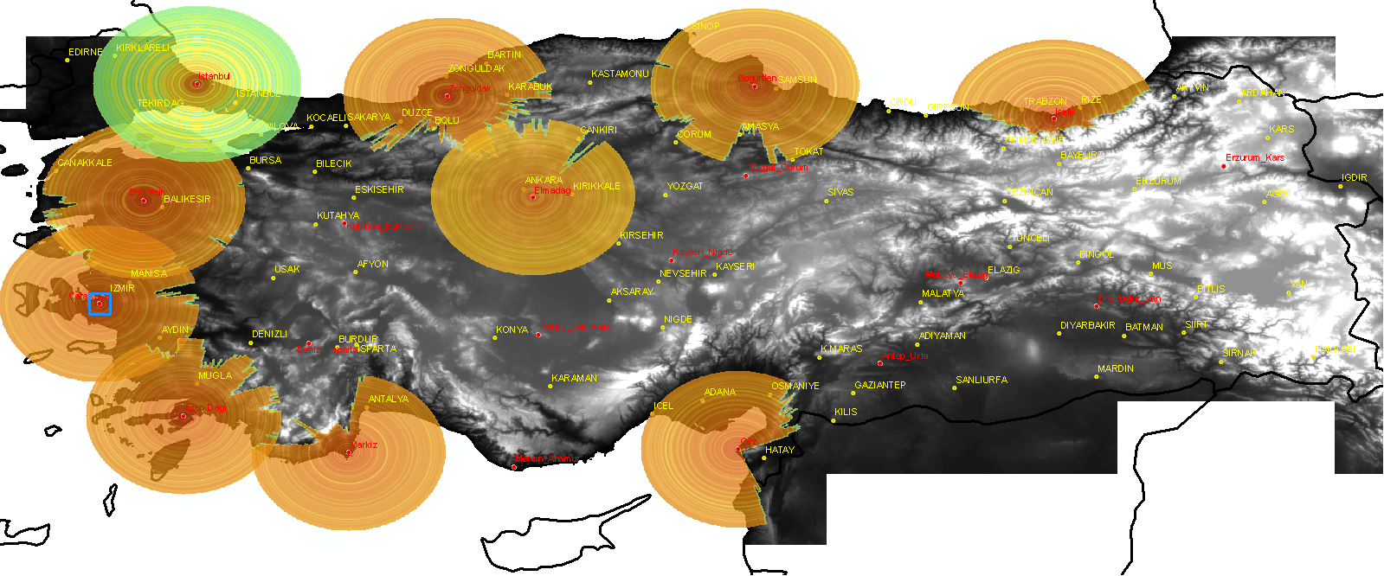
WEATHER RADAR NETWORK
EXISTING RADARS AND COVERAGE MAP
10 Radars@150 km coverage at 1000m

Slide 12
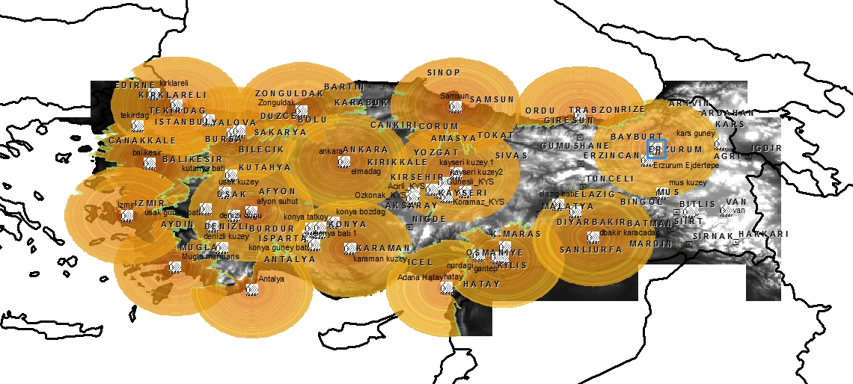
WEATHER RADAR NETWORK
EXISTING+PLANNED RADARS AND COVERAGE MAP
17 Radars@150 km coverage at 1000m

Slide 13
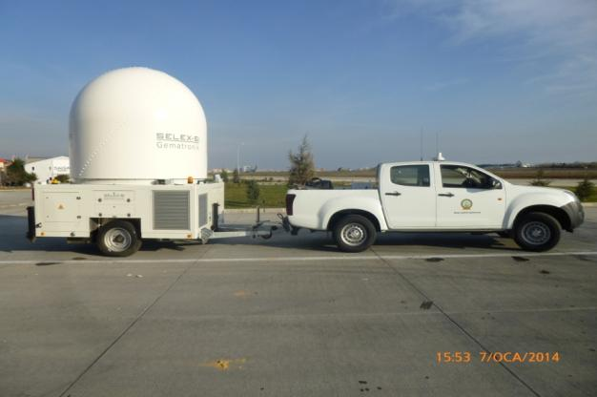
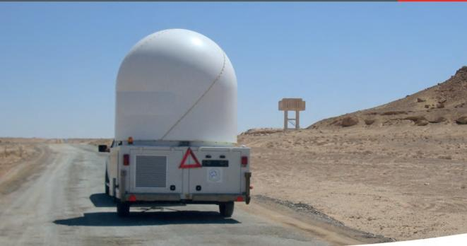
WEATHER RADAR NETWORK
MOBILE X-BAND RADAR
50-100 km observing range
High resolution and sensitive measurements
Low power, low cost
More sensitive to atmospherical attenuation
Better performance with dual polarization capability

Slide 14
CALIBRATION CENTER
LABORATORIES COMPLY WITH INTERNATIONAL STANDARDS
TSMS has a very well designed and equipped calibration center with 8 calibration laboratories.
Accredited Laboratories
(TS EN ISO/IEC 17025:2005)
Working by providing traceability
(TS EN ISO/IEC 17025:2005 )
Temperature
Relative humidity
Pressure
Wind speed
Precipitation
Solar radiation
Electrical
Wind direction

Slide 15
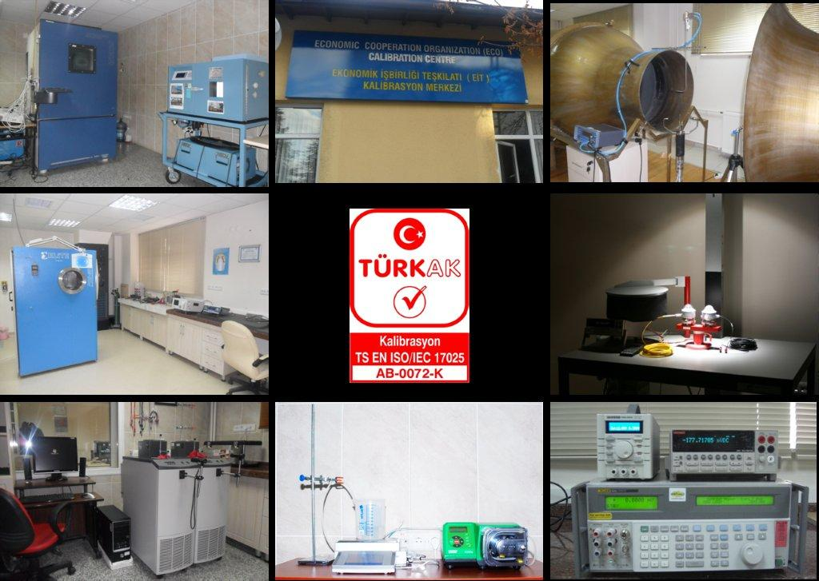
CALIBRATION CENTER

Slide 16











CALIBRATION CENTER
Calibration Center has been recognized as the calibration center for the members Economic Cooperation Organization
Afghanistan
Azerbaijan
Iran
Kazakhstan
Kyrgyzstan
Pakistan
Tajikistan
Turkey
Turkmenistan
Uzbekistan

Slide 17
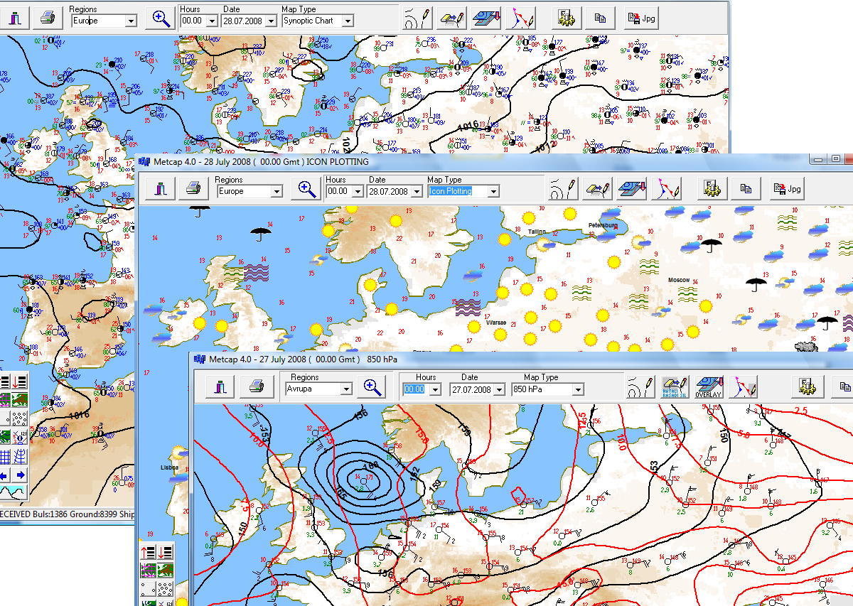
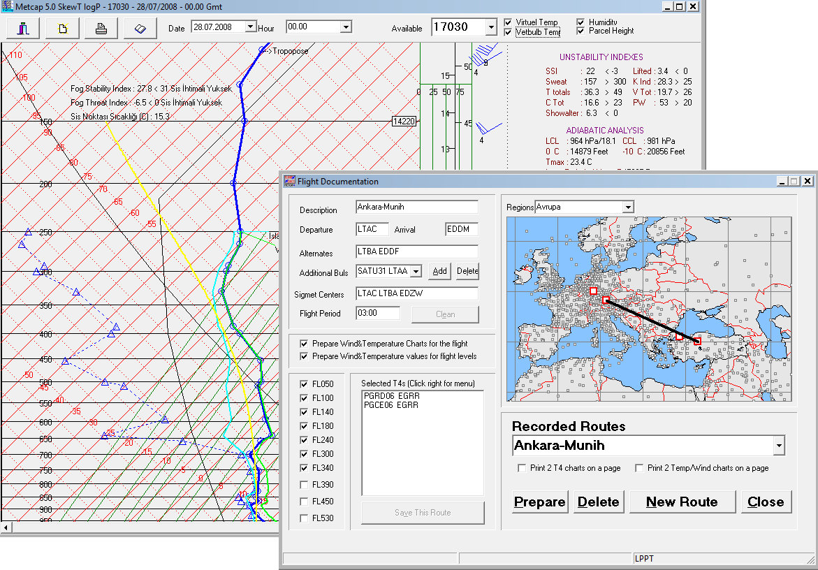
Data Analysis/Forecast
TURKMETCAP is a software package that meets whole requirements of a meteorological office such as:
  meteorological communication,
  data processing,
  map projection,
  data archiving and
  visualization of meteorological products (satellite, radar images and NWP products).
Used by
  Bosnia and Herzegovina,
  Azerbaijan,
  Turkish Republic of Northern Cyprus
  Yemen
TURKMETCAP is a free software package and it can be installed easily.

Slide 18
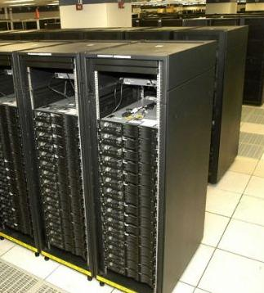
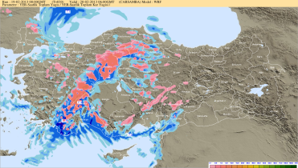
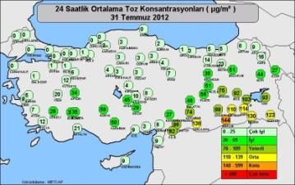
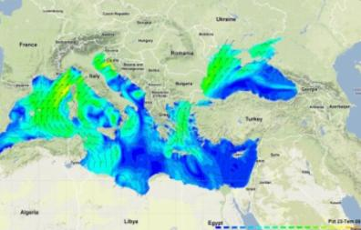
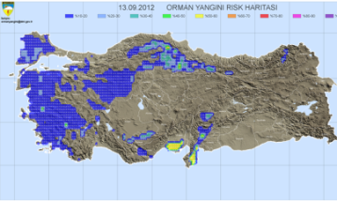
Data Analysis/Forecast
High Performance Super Computer
512 core CPU+256 core CPU
3.4 trillion process per second
NWP outputs

Slide 19
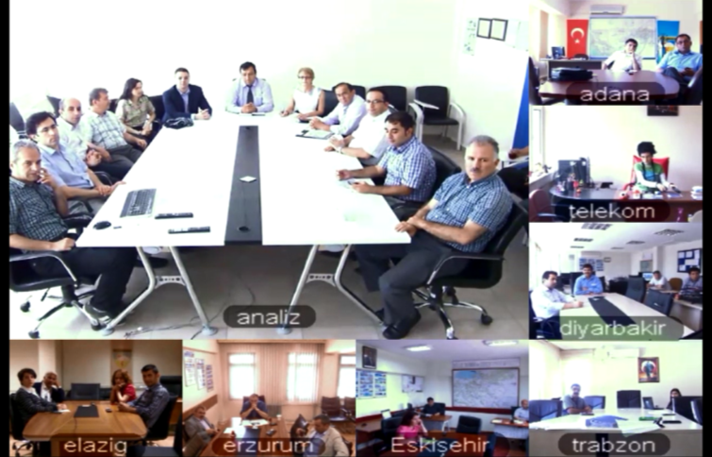
Weather Forecast
Regional Forecast and Early Warning Centers:
15 centers at regional directorates
Forecasting for 1.122 locations up to 5 days
İstanbul
İzmir
Eskişehir
Antalya
Afyonkarahisar
Adana
Kayseri
Konya
Ankara
Samsun
Trabzon
Erzurum
Elazığ
Van
Diyarbakır

Slide 20
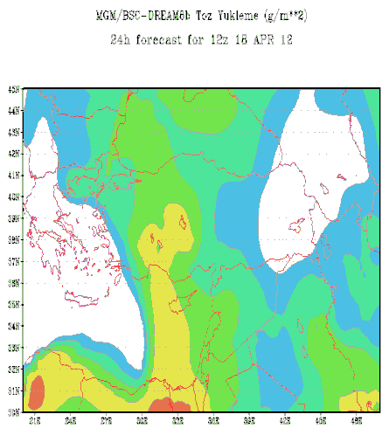
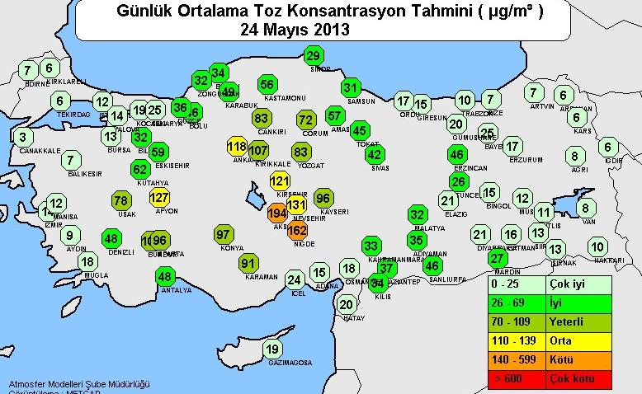
Research Studies
The BSC-DREAM8b dust transport model in cooperation with Spanish Met. Service.
The operational forecasts since June 2010.
Forecast products are published at the website.
http://www.mgm.gov.tr/tahmin/toz-tasinimi.aspx

Slide 21
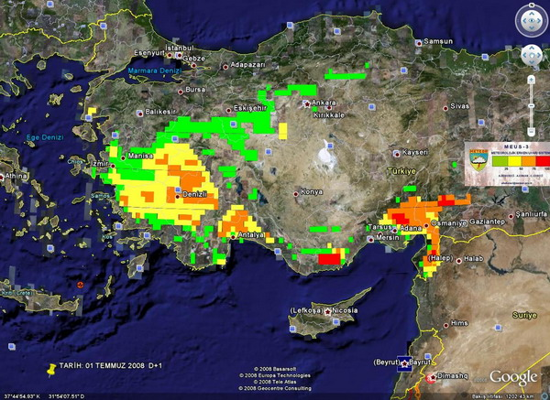
Research Studies
Forest Fires Early Warning System (MEUS)
Developed by TSMS.
Forest fire risk potential three days in advance.
Products are shared with General Directorate of Forestry.
Notes:
21

Slide 22
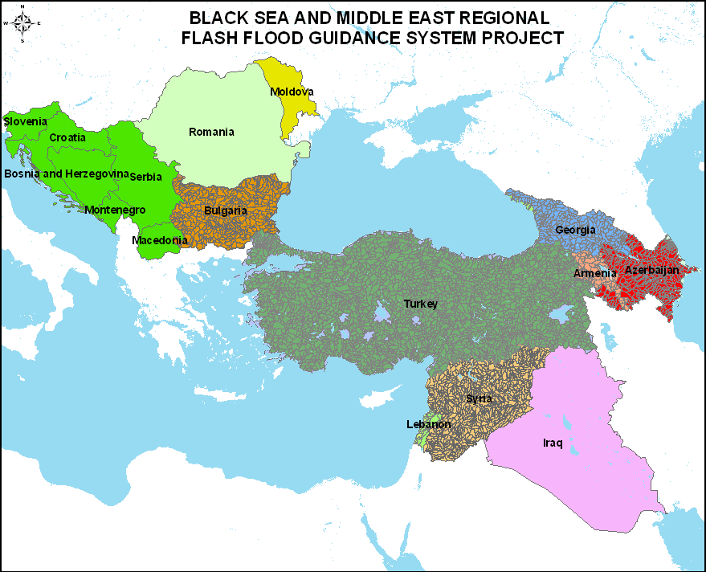
Research Studies
Black Sea and Middle East Flash Flood Guidance Project
TSMS is coordinating the Black Sea and Middle East Flash Flood Guidance project.
Bulgaria
Georgia
Armenia
Azerbaijan

Slide 23
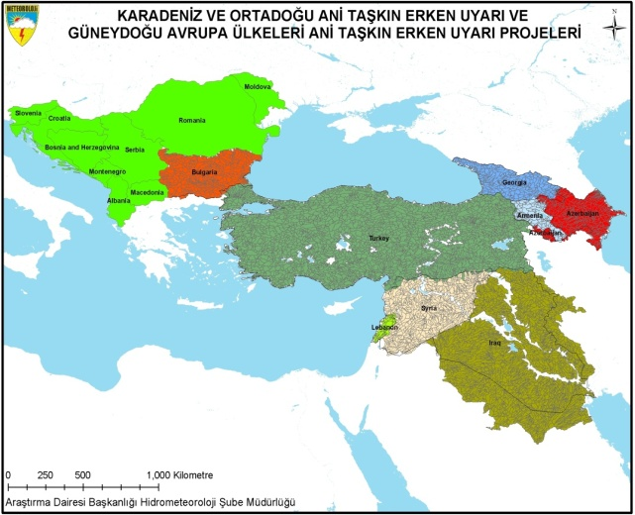
South East Europe FFG Project
SEE-FFG initial meeting was held in Ankara, Turkey on 22-24 January 2013. Croatia, Montenegro, Moldova, Serbia, Slovenia, Macedonia, Bosnia and Herzegovina and Albania were representatives and Turkey was accepted as the regional center of the project.

Slide 24
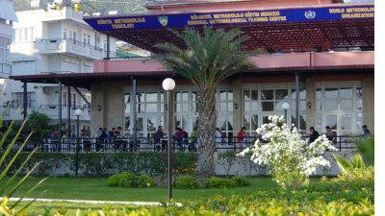
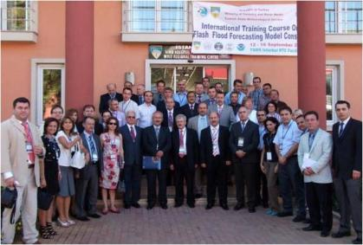
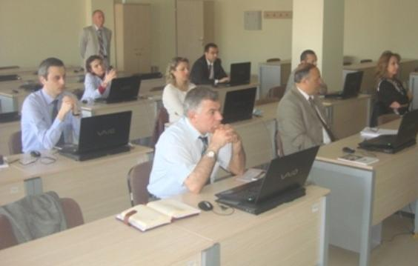
INTERNATIONAL RELATIONS
Training Activities
Regional Training Center of RA VI
Training facilities in Ankara, İstanbul, Alanya
More than 600 trainees from 100 different countries

Slide 25
REPUBLIC OF TURKEY
THE MINISTRY of FORESTRY AND WATER AFFAIRS
TURKISH STATE METEOROLOGICAL SERVICE
THANK YOU

